Slide 1
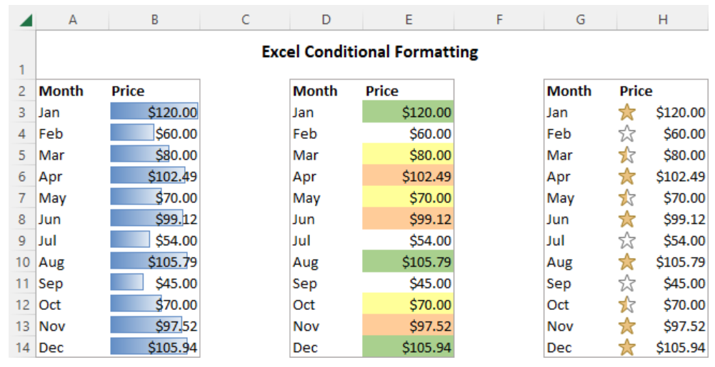
Conditional Formatting for Data Visualization in Excel

Slide 2
Conditional formatting in Excel is a powerful tool to visually represent data in a way that makes it easier to identify trends, outliers, and key information. Here’s how you can leverage
conditional formatting for data visualization, focusing on the most common methods like color scales, data bars, icon sets, and highlighting rules.

Slide 3
Step-by-Step Guide for Using Conditional Formatting in Excel:
1. Color Scales (Gradient Color Fill)
Best for: Showing variations in numerical data across a range, such as comparing values relative to each other.
2. Data Bars
Best for: Visually comparing values in a range, such as seeing relative performance or progress.
3. Icon Sets
Best for: Representing different categories, thresholds, or statuses visually (e.g., traffic lights for status, arrows for trends).
4. Highlighting Rules
Best for: Highlighting specific values or conditions (e.g., values greater than a target, duplicates, etc.).
5. Top/Bottom Rules
Best for: Quickly identifying top or bottom performers (e.g., top 10 items, bottom 10%, etc.).

Slide 4
6. Custom Formatting with Formulas
Best for: Creating more advanced conditions or applying formatting based on custom logic (e.g., showing different colors based on multiple conditions).
Tips for Conditional Formatting in Excel:
Limit the number of rules: Too many colors or icons can confuse the viewer. Stick to 2-3 key formats that highlight the most important trends.
Choose colors carefully: Make sure the colors you use are easy to interpret and differentiate. For example, avoid using red and green together since they may not be distinguishable to color-blind individuals.
Add a Legend or Key: If you’re using icon sets or color scales, consider adding a legend to explain what the colors or icons mean.
Keep it consistent: Ensure that the same rules apply across similar data types, so your audience can easily understand the patterns.

Slide 5
Thank you
anjushaji6@gmail.com

